Slide 1
Visual Listening In
Extracting Brand Image Portrayed on Social Media
Neeraj Kumar | Linda Samsinger | Theebana Rajendram | Vincent Rüegge

Slide 2
Agenda
Introduction
Benefits of the Web Application for Marketer
Description of the Deep Learning Model
From Image Data to Model Deployment on Web App
Problems and Improvements
How to use Deep Learning for Marketing? | Visual Listening In

Slide 3





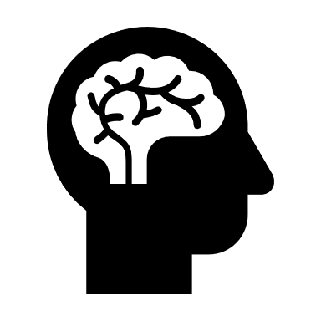
Introduction
Task
Design a Web Application to analyze brand images portrayed on Social Media.
Approach
Develop a Deep Learning Model to classify images according to predefined attributes and deploy the model to the Web Application.
Web Application
Request
Web Application
Response
Model Prediction
Deep Learning Model
Social Media URL of brand
Brand name
Association of brands with attributes
How to use Deep Learning for Marketing? | Visual Listening In

Slide 4
Benefits of the Web Application for Marketer
Consumer Insights
Benchmarking
New Opportunities
Better understand consumer’s brand perception
Brand positioning compared to competitors
Improve firm’s brand image
How to use Deep Learning for Marketing? | Visual Listening In

Slide 5
Description of the Deep Learning Model
Multiclass Image Classification Problem
Classify brand images according to the following 4 attributes:
→ Each attribute corresponds to one class.
Transfer Learning Approach
We use the pre-trained ResNet50 model and add our own last fully connected classifier layer.
Model Prediction
Predict class label for brand images.
Example: Brand «DAR-VIDA»
Fun | Healthy
Glamorous | Rugged
Input: Brand Image
Output: Class Label
How to use Deep Learning for Marketing? | Visual Listening In

Slide 6
From Image Data to Model Deployment on Web App
Image names instead of image data to speed up data preprocessing
We create attribute-specific datasets.
Each dataset contains attribute matching resp. non-matching images labeled as positive resp. negative.
Flickr
Images
Data Preprocessing
6500 images are used to train the model.
Labeled
Flickr
Images
Train-Test-Validation Split: 80:10:10
We train for each attribute a classifier independently with the corresponding attribute dataset.
Train
Validate
Test
Unlabeled
Instagram
Images
Label Classifier Model
Each image is given probabilities according to the prediction of the different classifiers.
Model Prediction
Web Application
Each image get a label based on the highest probability within the classifiers
Model Accuracy: 73%
How to use Deep Learning for Marketing? | Visual Listening In

Slide 7
Limitations and Improvements
How to use Deep Learning for Marketing? | Visual Listening In

Slide 8
Neeraj Kumar | Linda Samsinger | Theebana Rajendram | Vincent Rüegge

